Slide 1
Geospatial Analyst - Case Study
Submitted By-
Shivang Pandey

Slide 2
Case Study 1
Our client - a social impact organisation wants to understand the conditions of electricity in the district of Gorakhpur - Uttar Pradesh. They want to understand which parts of Gorakhpur are well lit-up (electrified) and which are not.
In this case study, VIIRS Night Time Lights (NTL) data of monthly composites from Google Earth Engine (GEE) can be used as they show illumination in during the night time and this data is corrected by several factors like, fire, cloud, etc.
GEE has been helpful for further data processing and analysis
For statistical proxy, value of average radiance band has been normalized between 0 and 1 to get rough idea about electrical distribution in the area

Slide 3
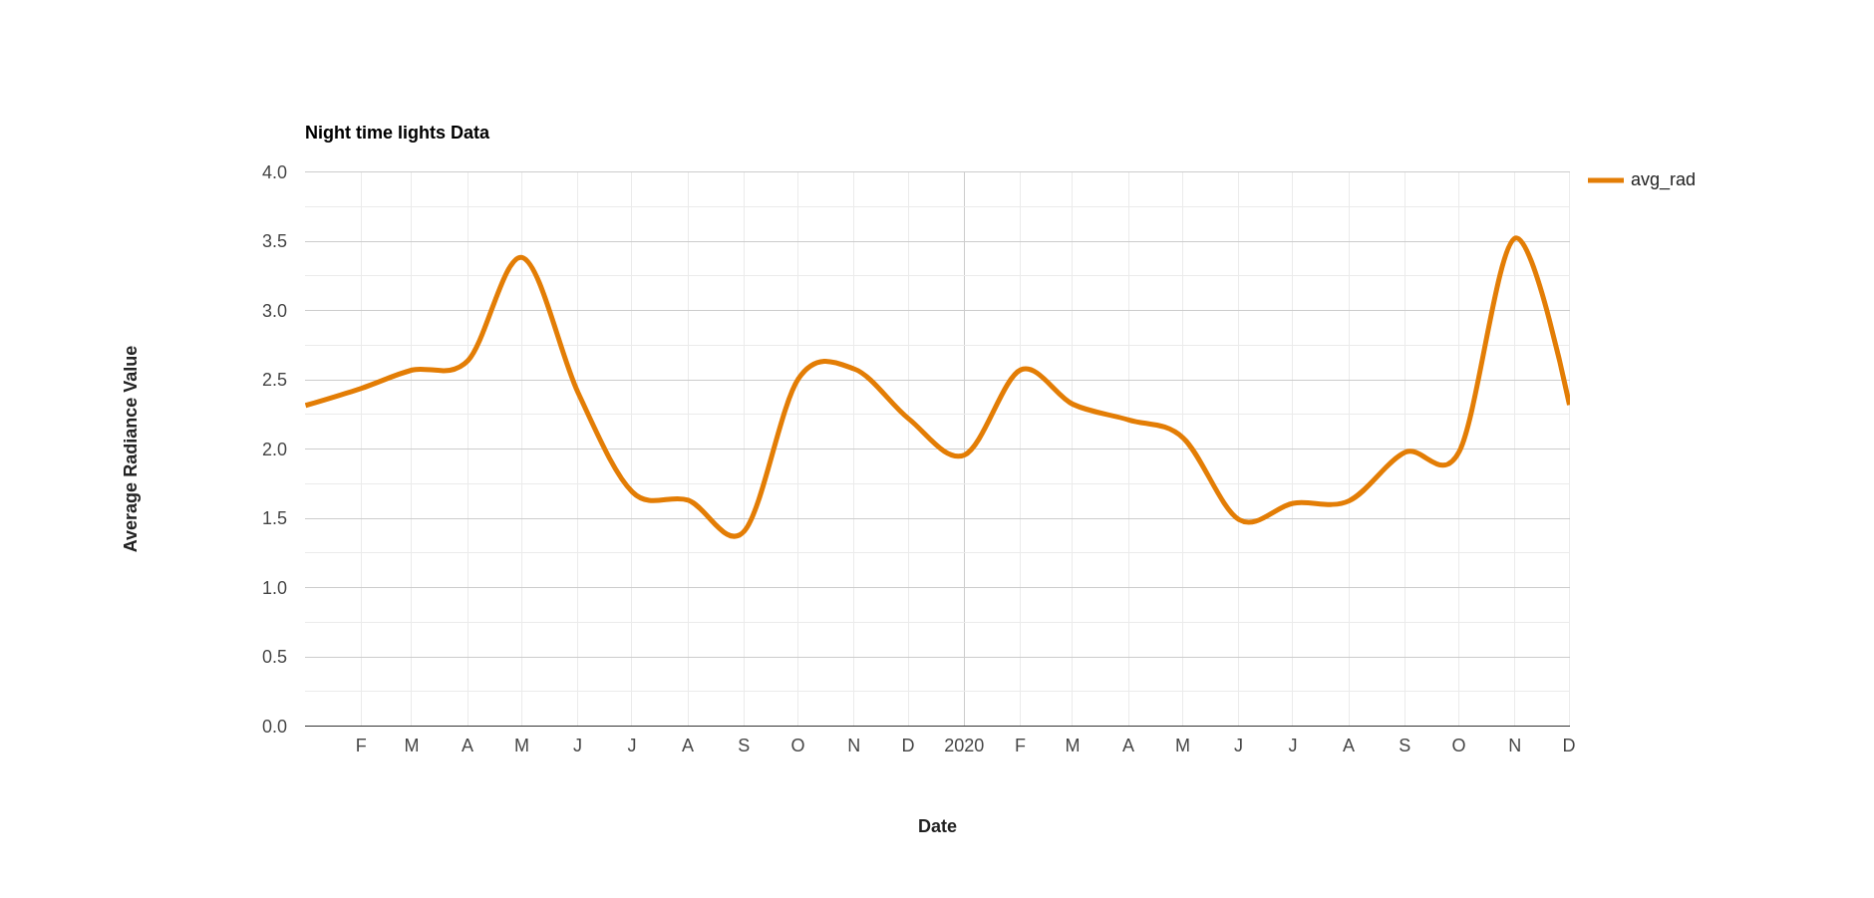
Data Exploration
Time Series Analysis of Monthly Average of radiance values

Slide 4
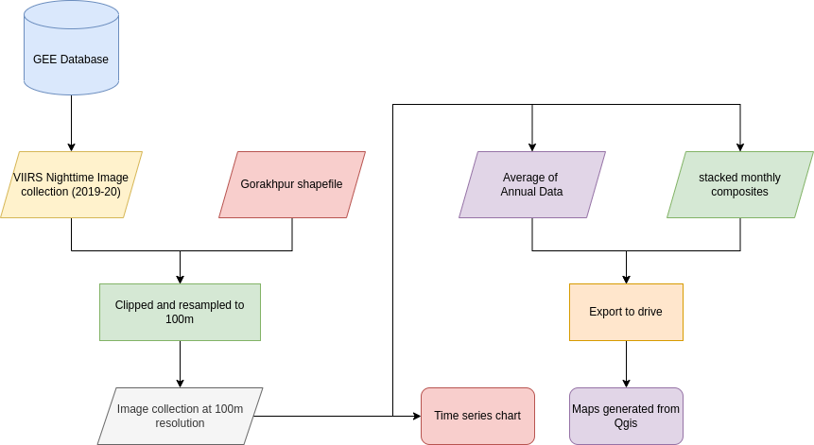
Approach

Slide 5
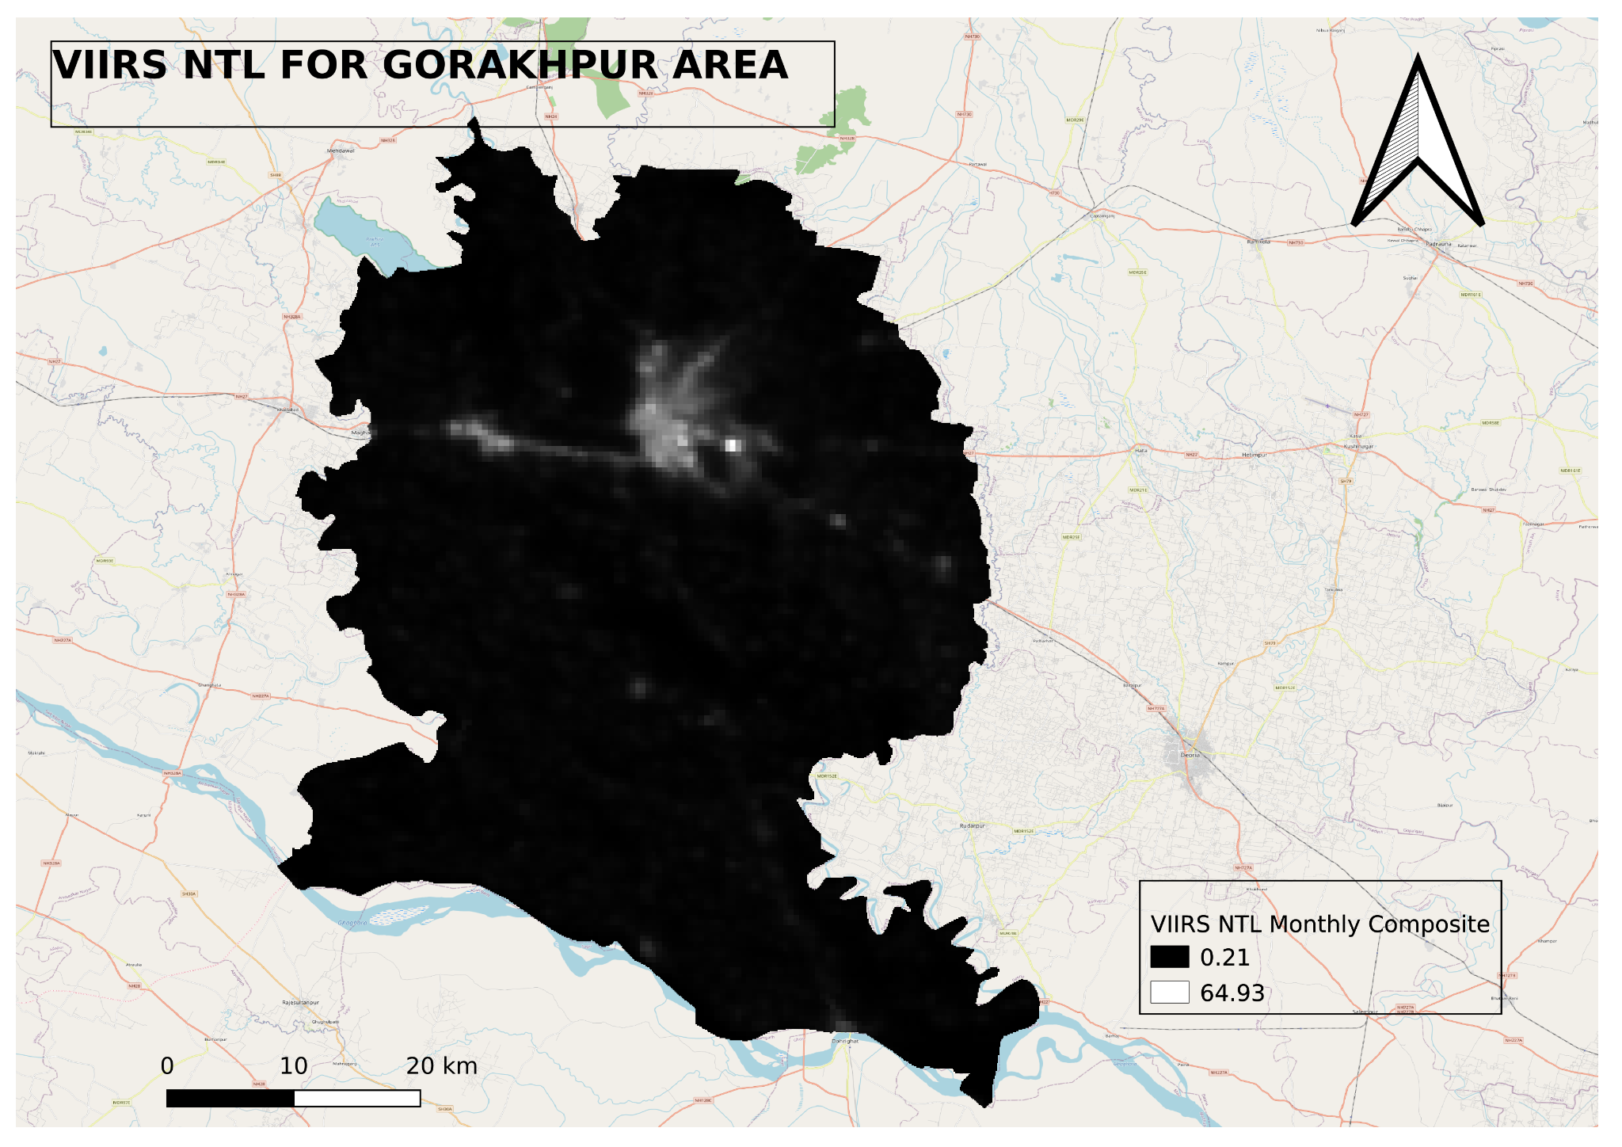
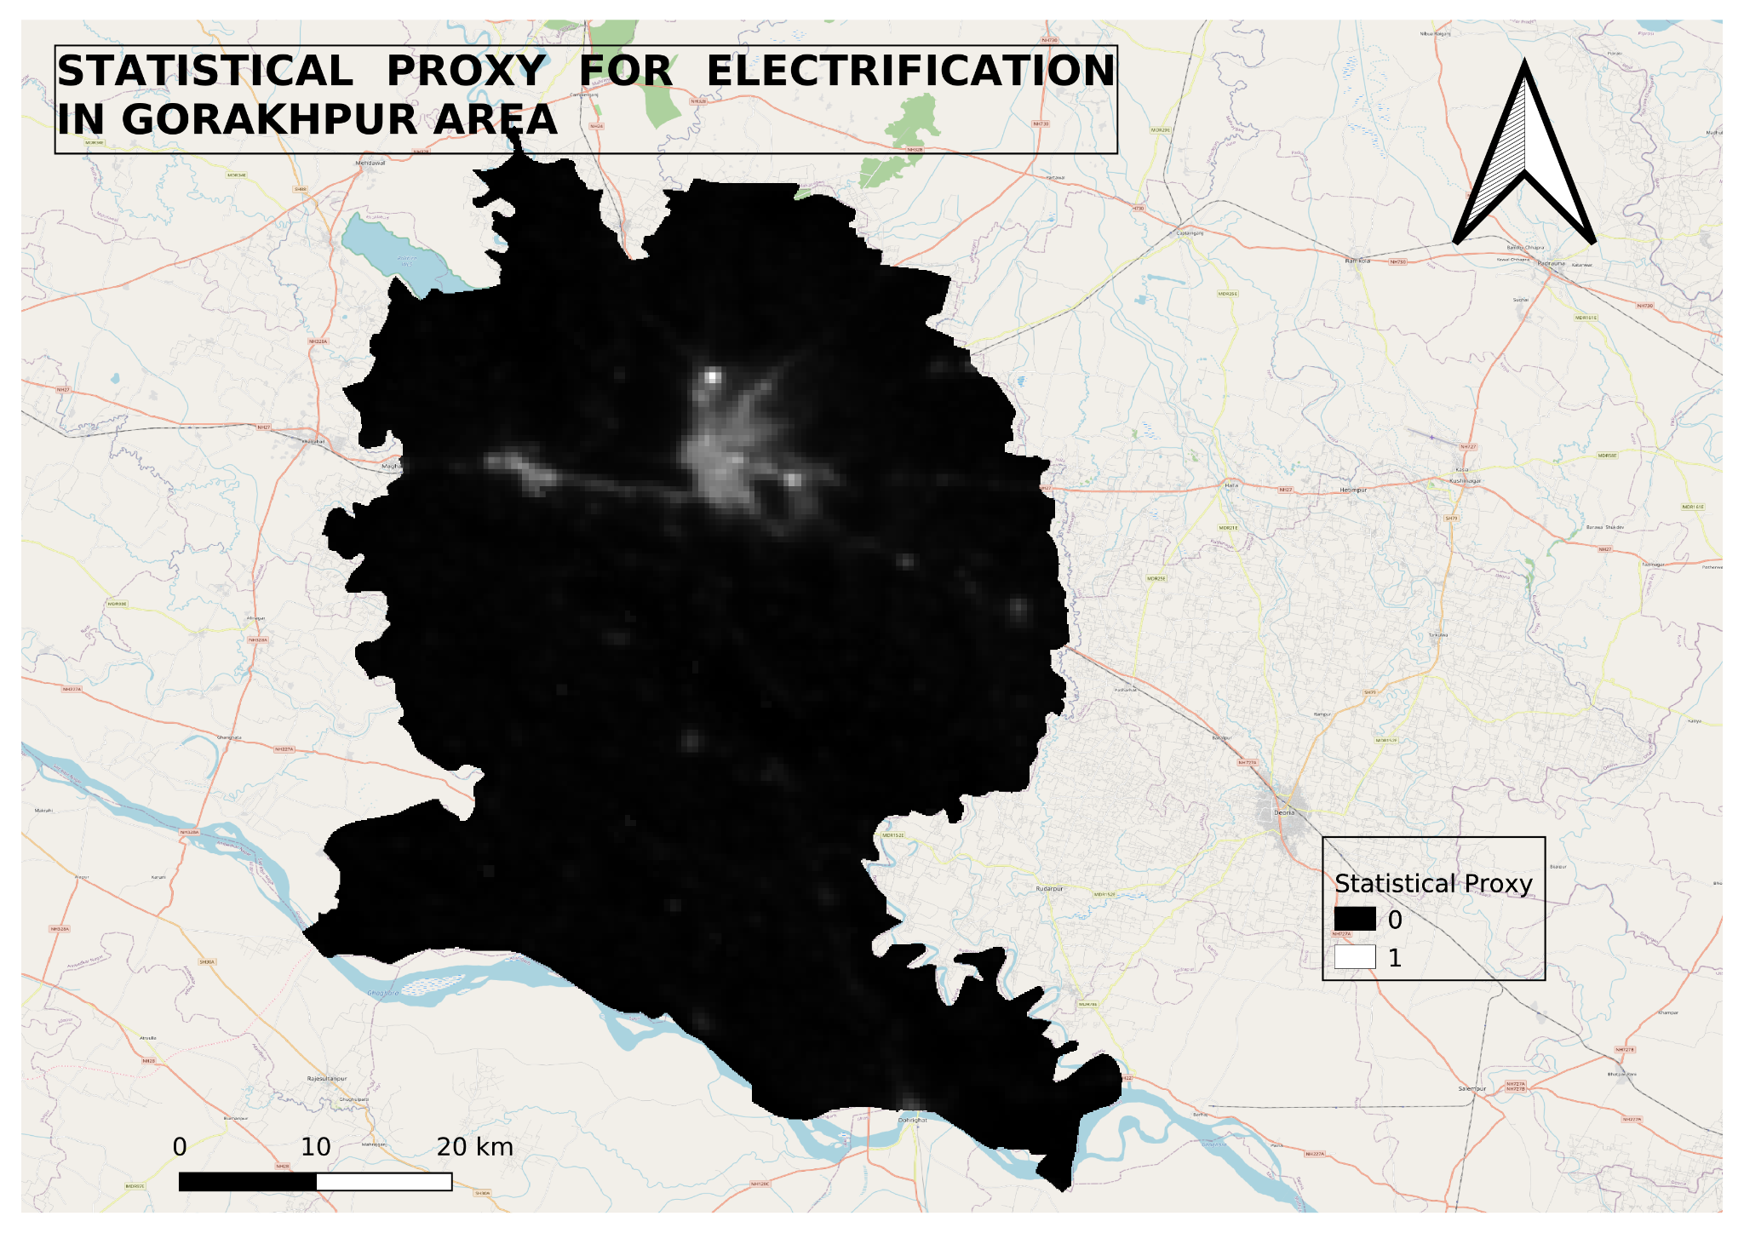
Outputs
Maps for VIIRS NTL Monthly composite stacked (left) and Statistical proxy of electrification (right) in gorakhpur area

Slide 6
Questions and Answers
1. What imagery should be used for this analysis?
VIIRS Stray Light Corrected Nighttime Day/Night Band Composites Version 1 or VIIRS Nighttime Day/Night Band Composites Version 1
2. How will you create an annual average from monthly composites of the satellite imagery for this study area?
By filtering ImageCollection from 1st January to 31st december and taking mean of it will give annual average from monthly composites

Slide 7
Case Study 2
Our client is a leading mall in Delhi - Select citywalk and they want to understand the neighborhood of their location in terms of population density and number of buildings.
Open Street Map (OSM) has been used as base map and for road network analysis, building parcel retrieval in this case study
Ministry of Housing and Urban Affairs’s model building by-laws for granule population estimation, which states that, the number of dwelling units are calculated on the basis of the density pattern given in the development plan, taking into consideration a population of 4.5 persons per dwelling unit.

Slide 8
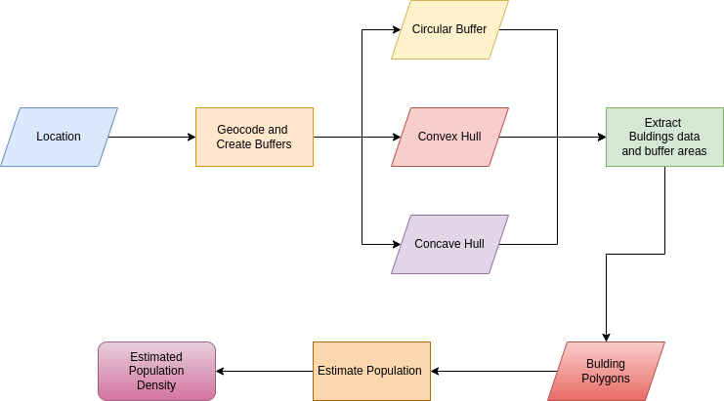
Approach

Slide 9
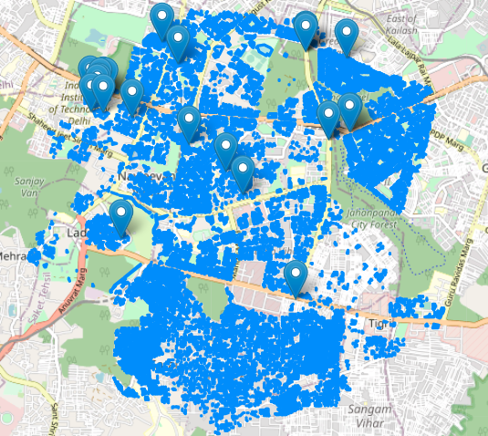
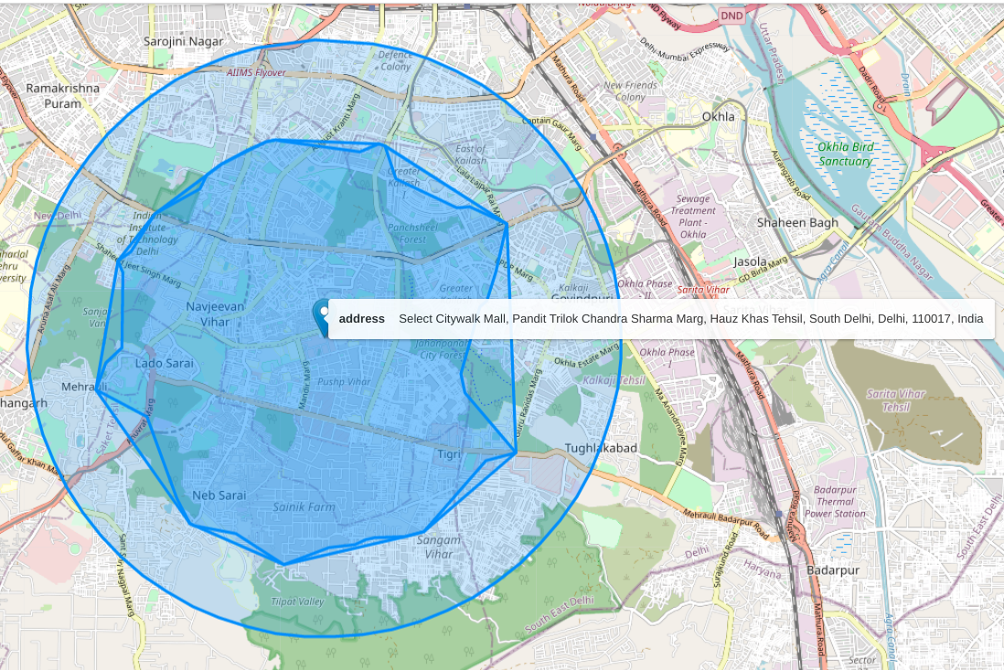
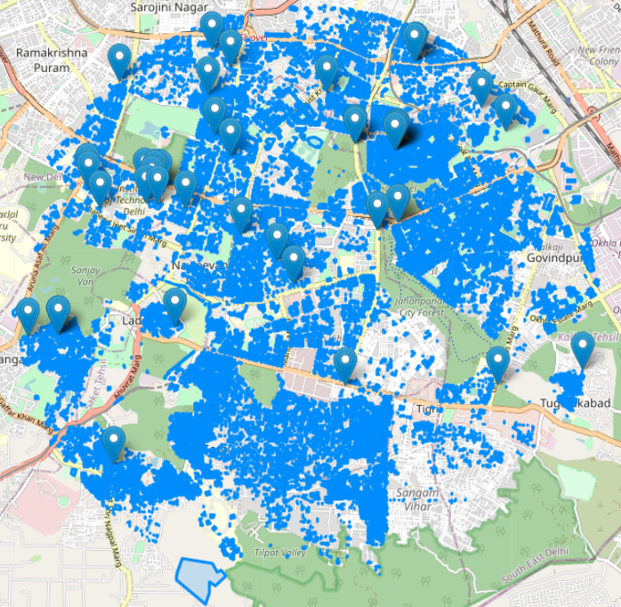
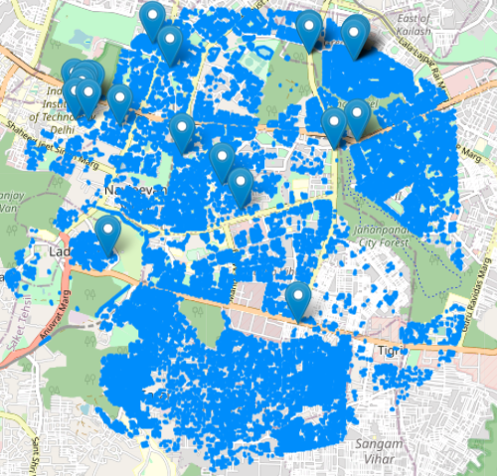
Visualization of 5km catchments
Buildings inside concave catchment
Circular, Convex and Concave buffers around Select Citywalk Mall
Buildings inside circular catchment
Buildings inside convex catchment

Slide 10
Outputs
Buffer size | Type of buffer | Area (kms. sq.) | Number of buildings | Estimated Population | Population Density (people per kms. sq.)
5 KM catchment | Circular Buffer | 78.41 | 36393 | 163768 | 2088.51
 | Convex Hull | 39.00 | 21677 | 97546 | 2501.02
 | Concave Hull | 35.13 | 19958 | 89811 | 2556.31
10 KM catchment | Circular Buffer | 313.66 | 73447 | 330511 | 1053.74
 | Convex Hull | 193.47 | 60469 | 272110 | 1406.41
 | Concave Hull | 178.91 | 58821 | 264694 | 1479.51

Slide 11
Questions and Answers
1. What imagery and open source geospatial data will you use for this analysis?
Open Street Map(OSM) data and Ministry of Housing and Urban Affairs’s model building by-laws for granule population estimation
2. How will you define the catchment of 5 km and 10 km around the location of Select Citywalk?
We can use geopandas buffer function for basic aerial distance of 5/10 km or we can create catchments using road network analysis as explained in code

Slide 12
THANKYOU

